Slide 1

Sprocket Central Pty Ltd
Data analytics approach
[Division Name] - [Engagement Manager], [Senior Consultant], [Junior Consultant]

Slide 2
Agenda
Introduction
Data Exploration
Model Development
Interpretation

Slide 3
Introduction
Identify and Recommend Top 1000
Overview
We are looking to boost sales by analyzing the provided datasets.
The aim is to recommend 1000 customers using the datasets, that Sprocket Central should target to reach their sales goals.
Contents of Data Analysis
Data Cleaning
Data Exploration
Model Development
Interpretation

Slide 4
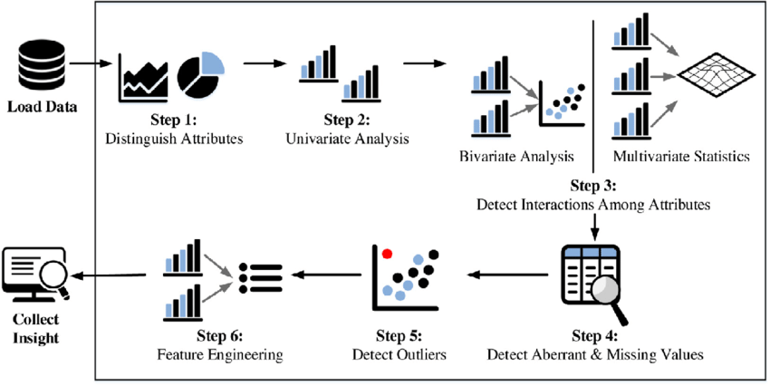
Data Exploration
Data exploration is the first step of data analysis used to discover patterns and trends in the data.
Importance of this step.
Reduces the risk of imbalance and skewness of the distribution.
High Correlation between multiple variables can lead to overfitting problem which can be discovered using correlation analysis.
To infer better results for our variables and make better predictors for future observations.
Removes the redundant values from the dataset by discovering missing values and outliers.

Slide 5
Data Assessment and Clean Up
Main points of Data Quality Assessment
Accuracy: Correctness of values
Completeness: Removing uncomplete data points
Consistency: Elimination of contradictions
Currency: Up to date values
Relevancy: Items contain meaningful data
Validity: Making sure the data is valid
Uniqueness: Ensuring there are no duplicates
 | Accuracy | Completeness | Consistency | Currency | Relevancy | Validity
Customer Demographic | DOB: Inaccuracies | Job title: Blanks | Gender: Inconsistency | Deceased customers: Not included | Default: Column deleted
Customer Address |  | Customer id: incomplete | States: Inconsistency
Transactions |  | Online Order: Blanks Brand: Blanks |  |  | Canceled status order: Filtered out | List price: Reformatted Product sold date: Reformatted
New Customer List |  | DOB: Blanks |  |  |  | Past 3 years bike related purchases: Reformatted Postcode: Reformatted Property value: Reformatted
In-depth analysis sent over email.

Slide 6
Model Development
RFM Analysis and Customer Classification
RFM (Recency, Frequency and Monetary) analysis is used to find customers that have displayed high levels of engagement with the business using the three parameters.
We use this method to split customers in 4 categories: ‘Bronze’, ‘Silver’, ‘Gold’ and ‘Platinum’. And we put highest significance on recency then frequency.

Slide 7
Interpretation
We want to target customers with the most recent engagement that buy as often as possible while ideally spending high.
By using the RFM analysis we can select the 815 Platinum users and select the other 185 from the gold category.
A further look into the data determines that if we order them by recency, we can make our selection from there.

